Slide 1
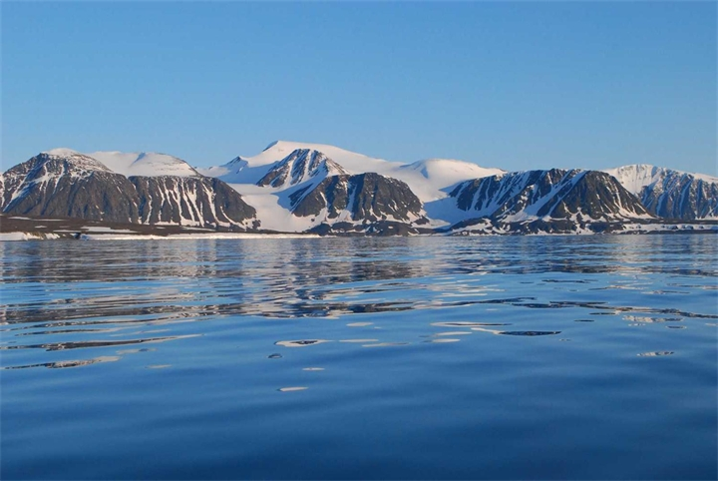
PROSPECTS FOR THE DEVELOPMENT OF THE NATIONAL PARK "RUSSIAN ARCTIC" IN THE TOURISM SECTOR

Slide 2
Tourism is one of the most popular forms of recreation in the modern world.

Slide 3
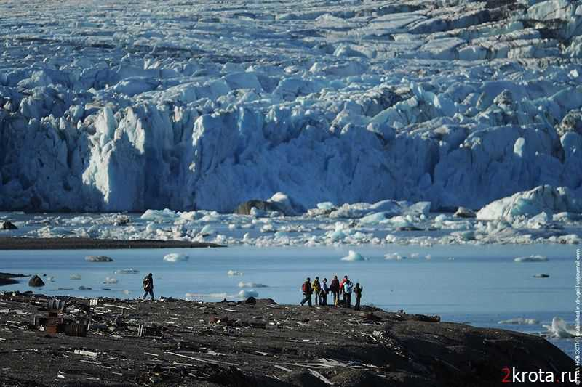
Arctic tourism
Arctic tourism has many prospects in the tourism sector

Slide 4
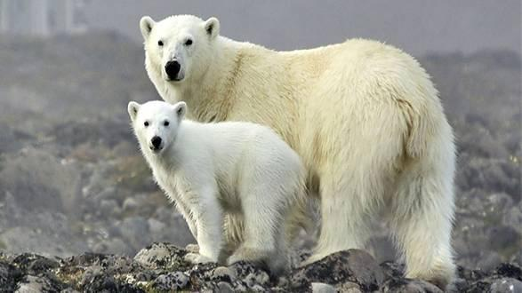
National Parks
National Parks are natural objects that are created for the protection and rational use natural and cultural objects that make up a nation-wide value, in order to enable people to gain additional knowledge and pleasure in contact with nature, culture and history of the people.

Slide 5
The National Park "Russian Arctic"
The process of creating a new specially protected natural areas in the Russian Arctic completed in 2011
Federal State Institution "National Park" Russian Arctic "created by a governmental decree dated December 11, 2010 № 2250, and referred to the jurisdiction of the Ministry of Natural Resources and Ecology of Russia.
National Park "Russian Arctic" - is an institution, primarily environmental, but also research and environmental education.

Slide 6
The main objectives of the park:
The conservation of particularly valuable natural, historical and cultural heritage and its use in educational, scientific and cultural purposes through the controlled organization of tourism.

Slide 7
Main activities:
Conservation of biological diversity and maintain the natural state of natural complexes and objects.
Research aimed at the development and application of scientific methods for biodiversity conservation.
Practical work on the conservation and breeding of rare and endangered species of animals and plants
Identification and inventory of historical and cultural heritage, the organization of their protection and study, restoration, preservation and restoration of historical and cultural landscapes
Conducting environmental monitoring.
Environmental and historical-cultural education.
Creating conditions for the development of controlled environmental and tourism.
Recreational construction and landscaping, creation and arrangement of nature trails and routes.
Detection and suppression of violations of the established regime

Slide 8
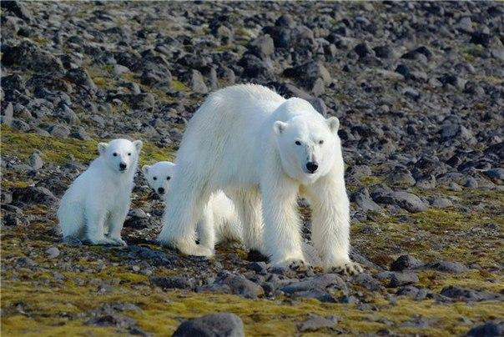
Tourism product
192 islands of the archipelago the Franz Josef Land, the northern tip
New Earth.
Glaciers of different genesis, icebergs, unique geological objects, including columnar basalts, dikes, ball concretions.
Roaring River with changing riverbeds and waterfalls.
The unique landscapes of the island, whose surface is covered
Arctic species of mosses, lichens and flowering plants.
Marine mammals - walruses, seals, sea hares, whales.
Polar bears.
Land animals - foxes, caribou.
Impressive bird colonies on cliffs.
Marine migratory birds accompanying cruise ships.

Slide 9
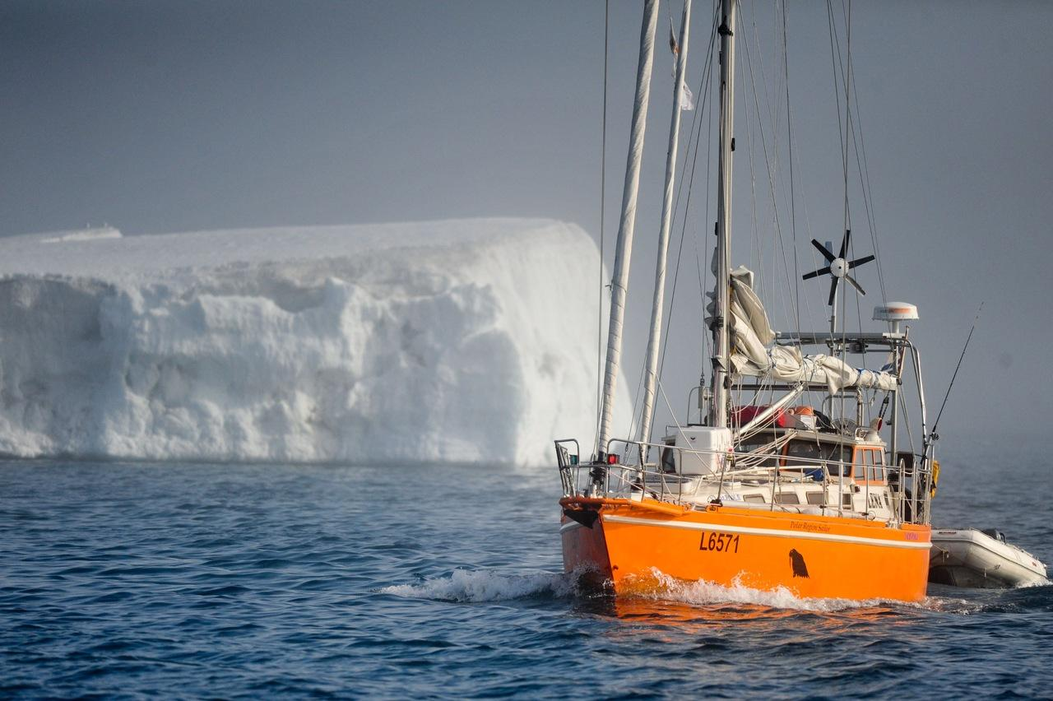
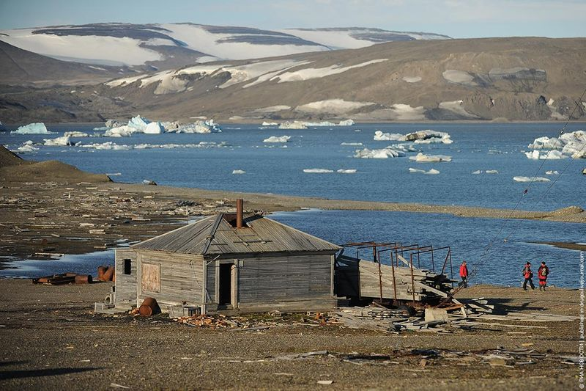
Types of tourism in the national park
Еxpeditionary tourism
Еco-tourism
Cruise tourism or sea

Slide 10
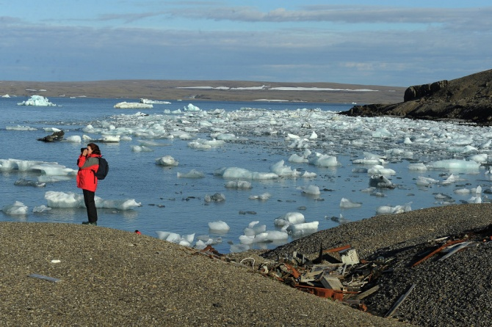
Analysis of the national park visitors in 2014
The total number of tourists:
2014: 738 (women-339, men-399)
2013: 636
2012: 1005
Сountry:
China-228, Germany, 135, Japan-70, US-46, Russia-42, Switzerland 31, Malaysia- 25, Taiwan 15, Rest of Europe, 56, other countries-53
References http://sakhaarcticconf.ru/wp-content/uploads/2014/12/4

Slide 11
SWOT-ANALYSIS
Strengths: | Weaknesses
- Is the natural state of the national park with a vast region of wild nature, direct contact with wildlife; -rare and unique natural objects that represent a high scientific interest; - The rich historical and cultural heritage; -North Sea Route; - Proximity to the well developed tourist areas (such as subjects in the Arkhangelsk region) - Cooperation with government authorities and local self-government, with other countries in the field of ecotourism; - State status and special protection of the National Park | - Poor infrastructure, or its complete absence in inaccessible regions; - Insufficient level of services; - Low efficiency of marketing and sales of the tourism product; - Low level of competence; - Narrow the scope of its tourist routes; - Low level of infrastructure
Opportunities | Treats
-The Development the most attractive tourist products ( tours) - Creating a new attractive tourist routes; - Improving the quality of services; - Save competitive prices for tourism products; - Increased dissemination of information and advertising | - The instability of the political and socio-economic situation in Russia; - Lack of government support for tourism; - Lack of foreign investment; - Environmental degradation (pollution) - Reducing the level of service and security risk of tourists - Lack of own funds and resources

Slide 12
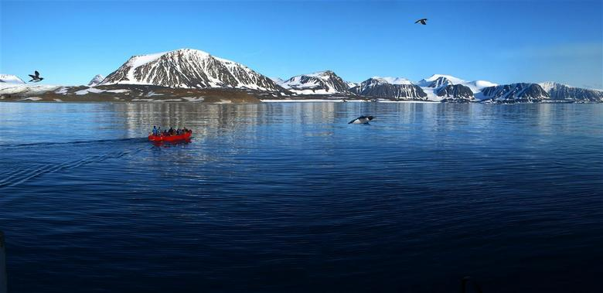
Prospects for the development of tourism in the national park "Russian Arctic"
Development infrastructure (accommodation, transport, communications, landscaping routes);
Search for funding modalities;
Education of people employed in tourism;
Development of services from the viewpoint of clients;
Improving the safety and comfort of tourists;
Improving of marketing and advertising;
Using tourism geopolitical situation in the region - Northern Sea Route

Slide 13
THANK YOU FOR YOUR ATTENTION

