Slide 1
Role of Contemporary Art Institutions in the Formation of Territory Tourist Brand
Yulia Shulyatyeva

Slide 2
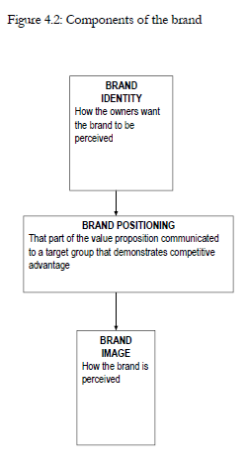
What is branding?
The aim: to maximize product or service value and create consumers’ aptitude and loyalty to it
Knox and Bickerton 2003

Slide 3
Place branding is…
the totality of the thoughts, feelings, associations and expectations that come to mind when a prospect or consumer is exposed to an entity's name, logo, products, services, events, or any design or symbol representing them

Slide 4
Country with powerful brand
Clearer domestic agreement on national identity and societal goals
A climate where innovation is prized and practiced
More effective investment promotion
More effective tourism and business travel promotion
A healthier ‘country of origin effect’ for exporters of goods and services
Greater profile in the international media
Simpler accession into other regional and global bodies and associations
More productive cultural relations with other countries and regions

Slide 5
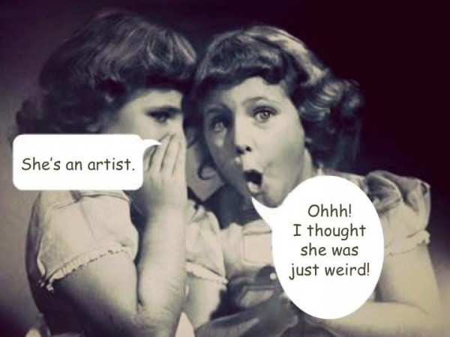
What is contemporary art?

Slide 6
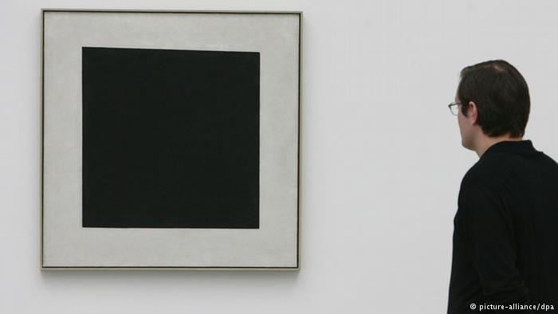
What is contemporary art?
All art has been contemporary
Maurizio Nannucci 1999
Time frame
The last 40 years
1960s-1970s
From 1945
The 21st century
Idea
Social character
‘artistic pluralism’
Being and time
Epatage, provocation

Slide 7
Branding and contemporary art. Foreign experience
Indicators of leadership
Volume of sales on art market
‘Capitals of contemporary art’ status
World known museums

Slide 8
The leaders of sales on contemporary art market
Place | Country | Volume, million euro
1 | China | 601
2 | USA | 552
3 | Great Britain | 231
4 | France | 26,3
5 | Germany | 10,9
6 | Taiwan | 9,9
7 | Australia | 5,2
8 | Singapore | 5
9 | Korea | 4,9
10 | Sweden | 4,8

Slide 9
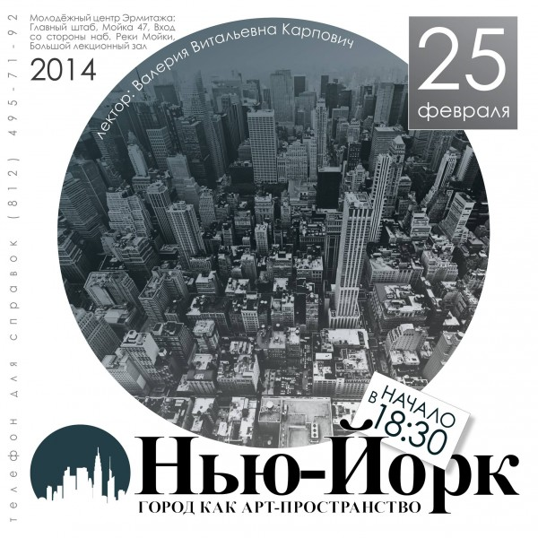
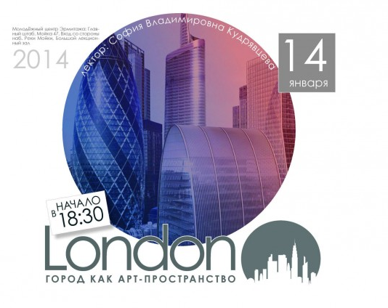
The Capitals of Contemporary Art – set of lectures in Hermitage Museum
Berlin
London
New York
Venice
Paris

Slide 10
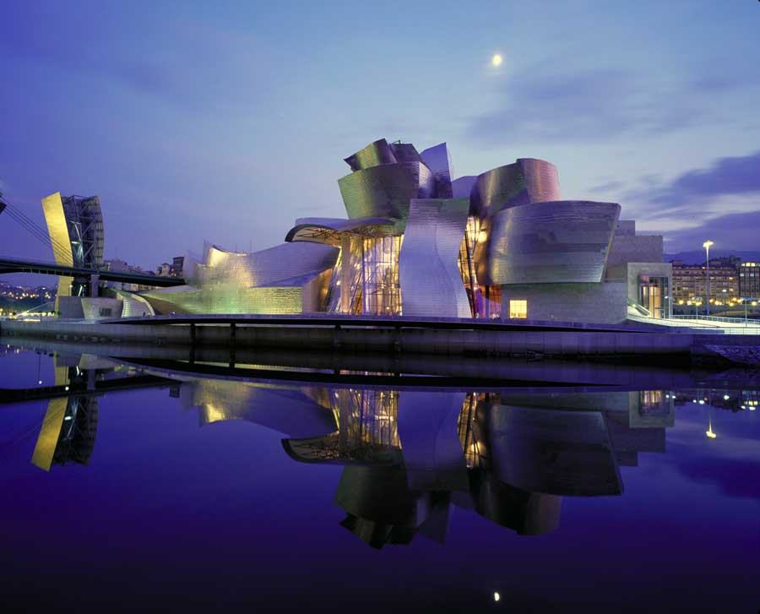
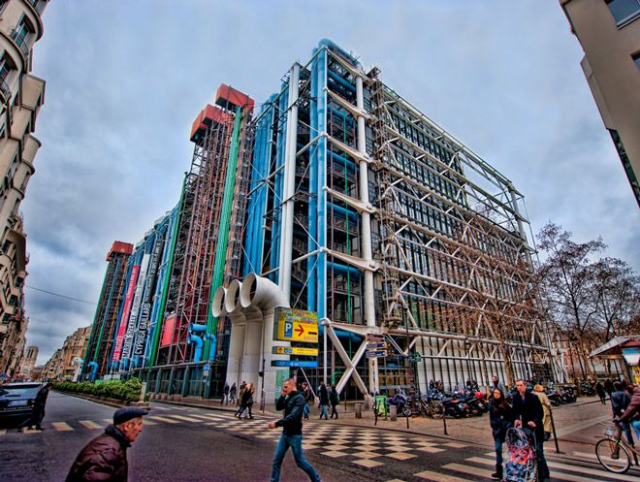
World known Contemporary Art Museums
London (Tate Modern)
Bilbao (Guggenheim Museum)
Paris (Centre Georges Pompidou)
San Francisco (Museum of Contemporary Art)
and others

Slide 11
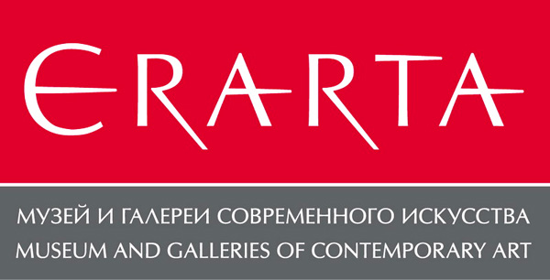
Branding and contemporary art. Russian experience
One auction house specialized in contemporary art
Nearly 10 museums of contemporary art

Slide 12
Reasons for unpopularity of contemporary art in Russia
The Soviet past
The absence of contemporary art explanation and education
Weak development of art-marketing strategies
Weak support of government and locals
Lack of marketing of contemporary art institutions

Slide 13
Research
Hypotheses:
Contemporary art plays insignificant role in destination branding of St. Petersburg
Contemporary art is of less interest for Russian tourists than for foreign tourists
Large well-known museums pay more attention to contemporary art promotion and attraction of tourists
Tourist brand of St. Petersburg
Contemporary art institutions

Slide 14
Research methods
Methods
Content analysis
Expert survey
Travel companies
City and government portals
Tourist sites

Slide 15
Content analysis
Search for: contemporary, contemporary art, contemporary museum, art gallery, art center, underground, nonconformist, creative, innovation
Tourist agencies
Domestic supply
Supply abroad
Government
Tourism Development Committee
Culture Committee
Entertainment
Popularity of sites among tourists
Committee on External Relations

Slide 16
Criterion for the choice of experts
Working with contemporary art
Stable organization of exhibitions
History and scale
Creative approach towards organization of art spaces
High level of publicity
Focus both on locals and on tourists attention
Cooperation with leading art experts and critics and leading museums of city or country
Participation in the cultural and educational programs
Vigorous activity in the framework of different art projects
Focus on European art practice
Activity on international level

Slide 17
Contemporary Visual Art Institutions
Institutions
Museums
Art galleries
Creative spaces
Contemporary Art
Classical

Slide 18
Contemporary Visual Art Institutions. Situation in St. Petersburg
Institutions
Museums
18 Art galleries
7 Creative spaces
3 Contemporary Art
5 Classical

Slide 19
Potential results. Content Analysis
Contemporary art plays insignificant role in destination branding
Local tourist agencies
Government programs
Entertainment sites
Contemporary art is of less interest for Russian tourists than for foreign tourists
Foreign tourist agencies VS Domestic tourist agencies
Large well-known museums pay more attention to contemporary art promotion and attraction of tourists
Entertainment sites

Slide 20
Potential results
Contemporary art plays insignificant role in destination branding
“Our art is for serious collectors. If a person comes to the city and wants to buy a picture for 100 or 200 euro or dollars we cannot help him or her”
“There is no such goal as attracting tourists to our gallery”
“Tourists are not the target audience of gallery since 2010. Our clients are collectors, which are interested in this direction. Sometmes tourists visit the gallery but these are individuals”

Slide 21
Large well-known museums pay more attention to contemporary art promotion and attraction of tourists
“We do everything what we can. Government should deal with promotion”
“We are commercial gallery, we are not like NCCA. We have our own objectives. We open and show some names. The next step is sale. Our final goal for pictures to find their owners”
“Erarta is very touristic place, they have a lot of tourists”

Slide 22
Contemporary art is of less interest for Russian tourists than for foreign tourists
“All our activities are unusual and creative for an ordinary person, since people in our country are not accustomed to contemporary art”
“Russia resists against contemporary art”
“There is of understanding of contemporary art in Russia. People like or dislike something on intuitive level. In order to understand a person should know the history of 20th century art. Those who didn’t go abroad and has not been to the largest museums of contemporary art do not know what is it like”

Slide 23
Limitations of research
Difficulties in access to some experts
Difficulties of assessment of the market on a full scale
Subjective approach in the assessment of market

Slide 24
Future research
Extending the studied market segment :
Institutions
Geography
Developing of more perfect research methods (survey, scripts for content analysis)
Developing of city map or city excursion routes

Slide 25
Thank You for attention!

