Slide 1
PULSATING EFFECT INFLUENCE
Elkanova Elena
Higher School of Economics,
Saint-Petersburg, Russia
elen.elkanova@gmail.com

Slide 2
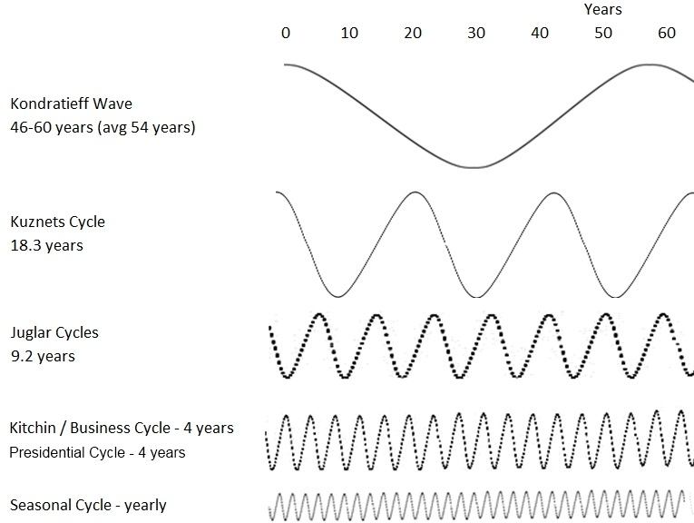
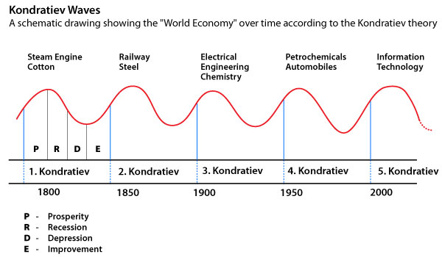
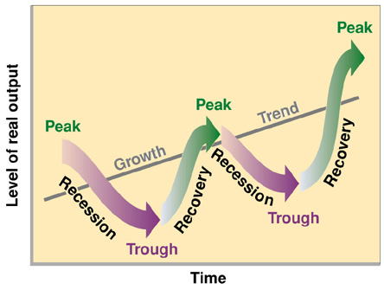

Slide 3
Seasonality
In statistics, time series data is data collected at regular intervals. When there are patterns that repeat over known, fixed periods of time within the data set it is considered to be seasonality, seasonal variation, periodic variation, or periodic fluctuations.
consumption seasonality (Boffa F., Succurro M., 2012; Butler R. W., 1994; Connell J. et al., 2015; Higham J.& Hinch T., 2002)
may be caused by various factors (way of life, vacation time, school holidays, weather, habits, preferences, certain seasonal activities)
summer peaking problem (overseas visitors)

Slide 4
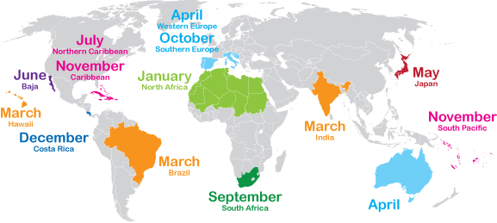
A chart of the best shoulder season destinations
https://www.greatescapepublishing.com/calendar-best-shoulder-season-destinations/

Slide 5
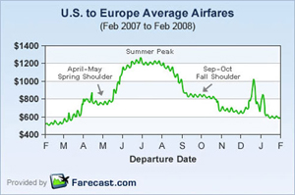
Pricing strategy

Slide 6
Pulsating effect
Seasonal cycle Organizational cycle
Demand fluctuations ?
Market-driven factors ?
Consumer seasonality Production seasonality
Industry level Organizational level
Pulsating organization concept
(seasonal organizations, events)
Toffler, 1991
Adhocracy idea
Preparation (pre-activity)
Mobilization (activity)
Decline (post-activity)
Hibernation (non-activity)

Slide 7
Pulsating organizations
being focused on concrete task;
having prominent stages of planning cycle (preparation, mobilization, performance decline and hibernation);
cycling (iterative technological process);
sequential stages change;
planned character (the stages are planned).
Project organization
having prominent stages of planning cycle (initiation, planning, execution, closure);
sequential stages change.

Slide 8
Pulsating organizations in tourism and event industries
Amusement parks (Divo ostrov)
Ropes courses (Norway park)
Ski resorts (Igora)
Street art museum
Boat trips and river excursions on the waterways of St. Petersburg
Festival Stereoleto
Geek Picnic, etc.

Slide 9
Current state of knowledge
Macroeconomics (Cycles theory )
SOM theories (service management)
Event management
Service Operations Management Theory Classic idea (Chase R.B. & Tansik D. A., 1983; Daniels P., 1985; Langeard E. et al., 1981; Levitt T., 1972; P.; Lovelock C.H., 1983; Thomas D. R. E., 1978; Zeithaml V. et al., 1985)
Systematic service production process (Normann, Gummesson, Shostack; J. Sundbo, 1994); Service model design (Gummesson, 1991; George & Brown, 1991; Shostack, 1981, 1984); T. Levitt “The Production Line Approach to Service’’ (1972) and ‘‘The Industrialization of Services’’ (1976)

Slide 10
Managing pulsating effect
Pulsating effect influence on:
planning;
marketing policy;
financial policy;
organizational structure;
procurement;
capacity (facility, material resources);
human resources.
HRM in sports events (C. Hanlon; 2002)
HRM in festivals: 2014 - event industry in Saint-Petersburg

Slide 11
Organizational structure
Flexible adaptive organizational structure ; Complex structural arrangement, not stable
Reorganization implies:
Inflows & outflows of employees
Movement from centralization to decentralization and back
Degree of differentiation: horizontal and vertical - to accommodate fulltime, outsource and seasonal personnel.
Decision-making process: centralized - for major decision making throughout the year; decentralized – preparation and mobilization stages
Formalization:
This is due to the number and variety of personnel arriving and departing at different times, all of whom require immediate information on various issues. Formalization requires the increased use of mechanisms such as rules, job descriptions, detailed policies and procedures.
[Hanlon, 2002]

Slide 12
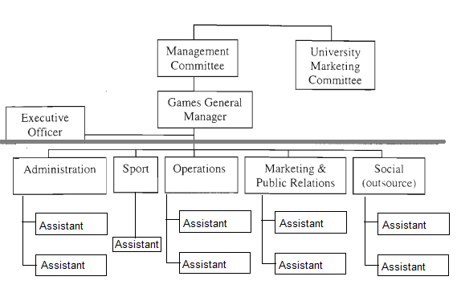
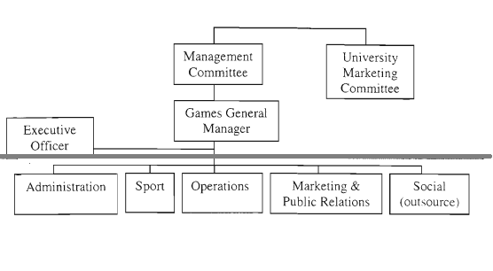
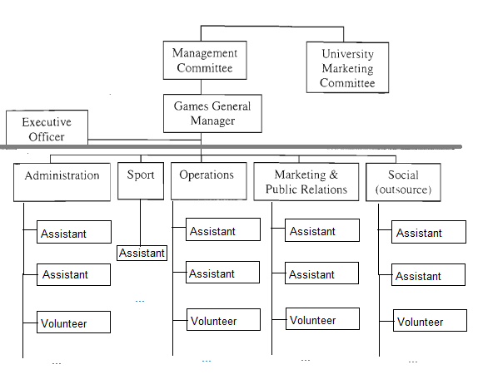
Example: Organizational structure change

Slide 13
Overcoming seasonality/pulsating effect
Country/city level:
Destination image
Marketing tools (differential pricing and taxation; providing new attractions andevents; diversification; trying to lengthen the main season or establishing additional seasons; encouraging the staggering of holidays; encouraging domestic tourism in off-seasons)
Off-peak events (J. Connell, S.J. Page & D. Meyer)
Organizational level:
Pricing strategies
Wind down
Diversify services

Slide 14
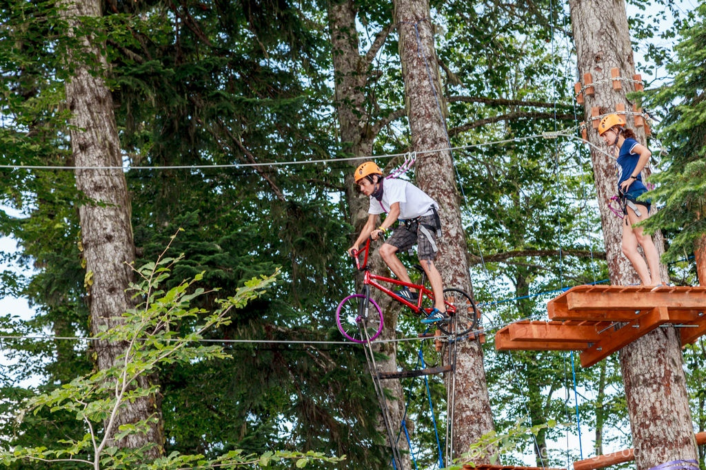
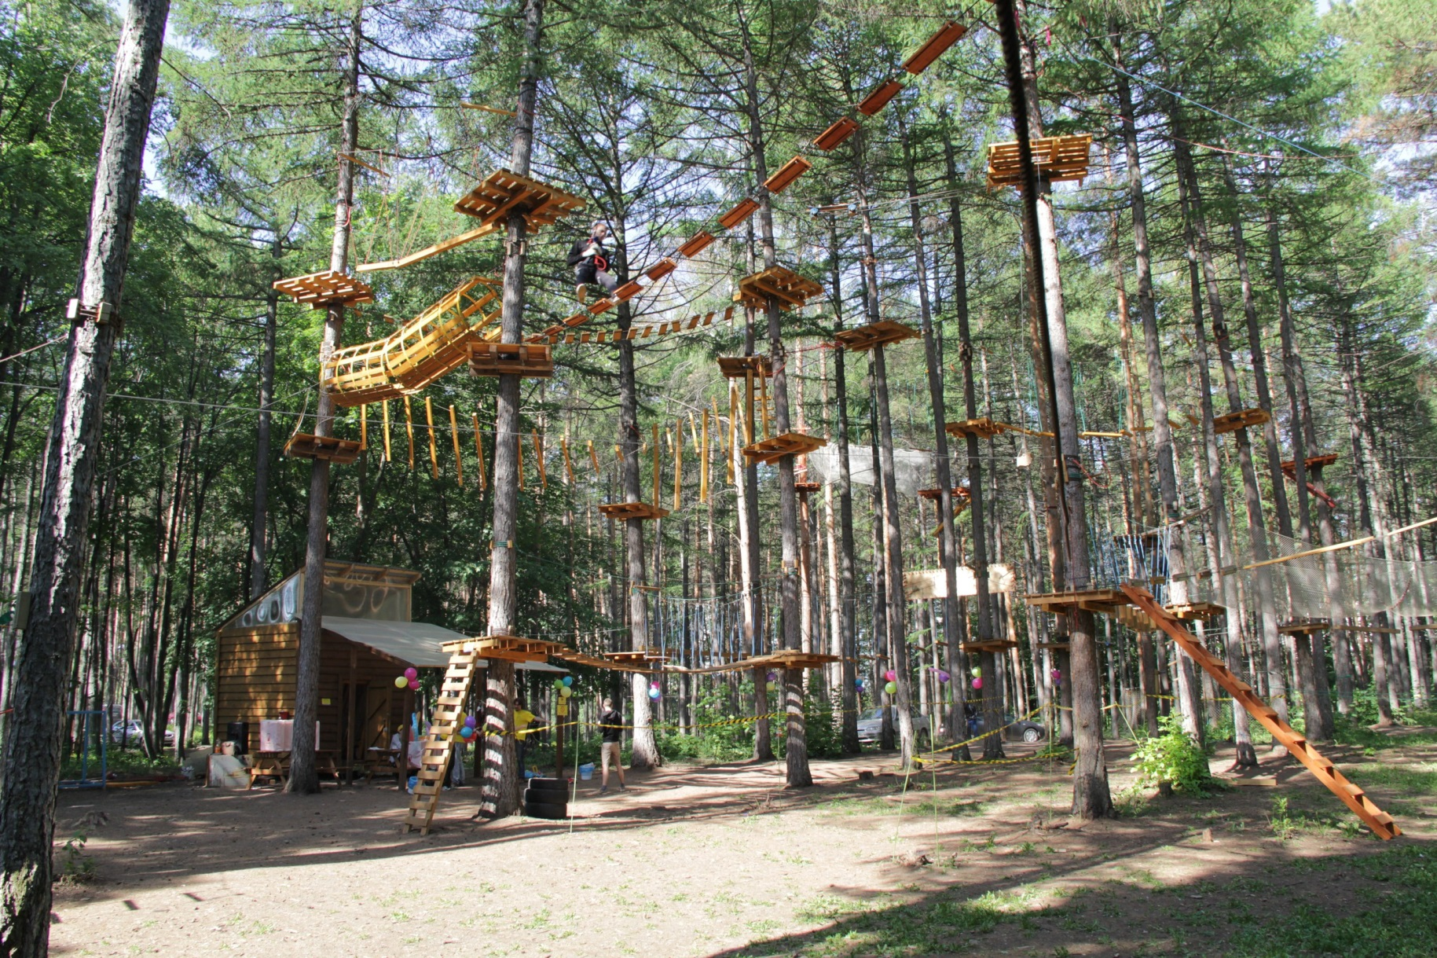
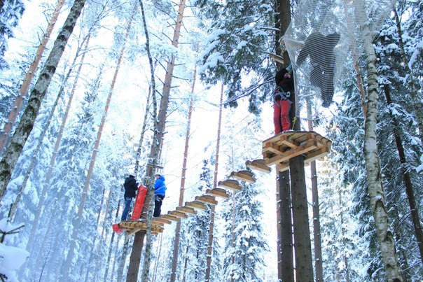
Norway Park

Slide 15
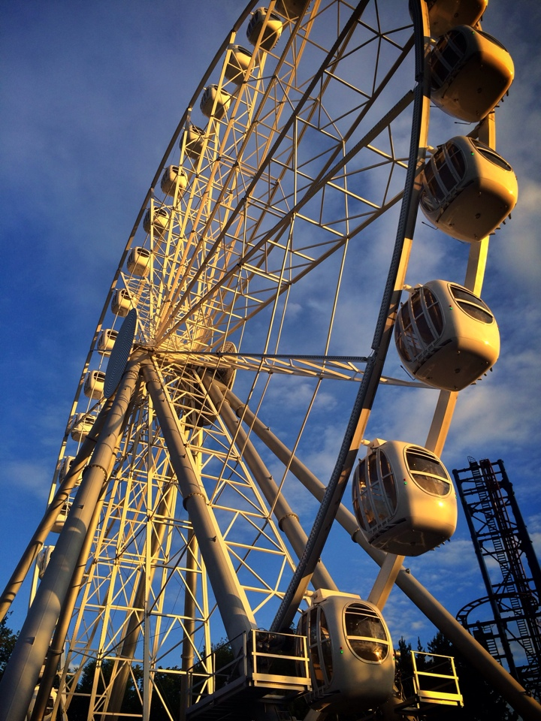
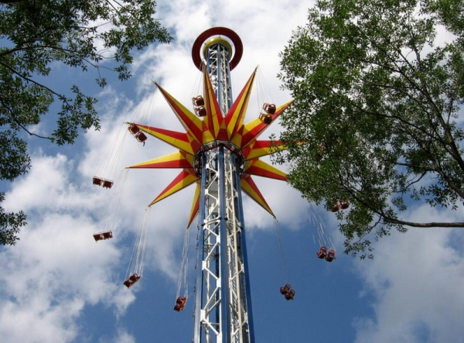
Divo ostrov

Slide 16
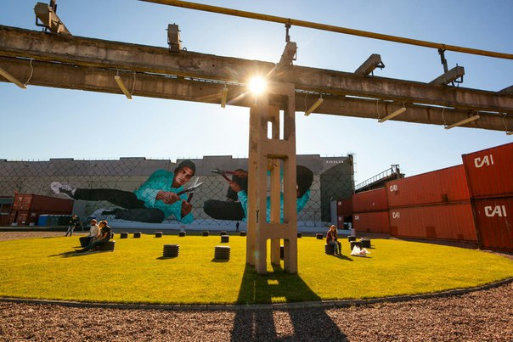
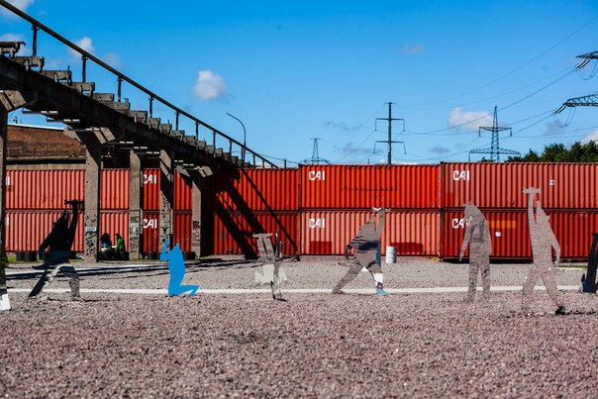
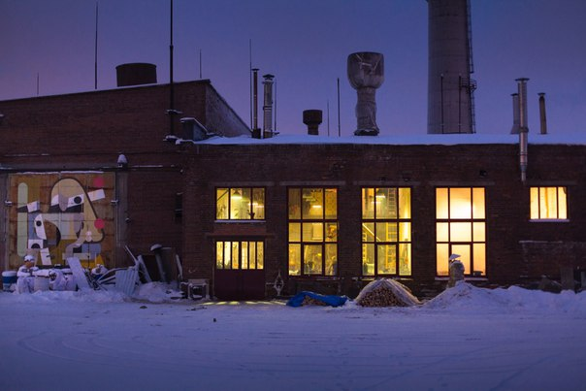
Street art museum

Slide 17
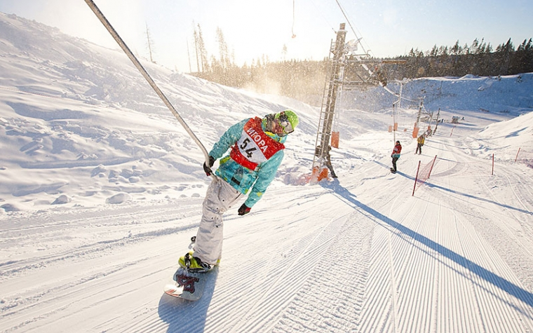
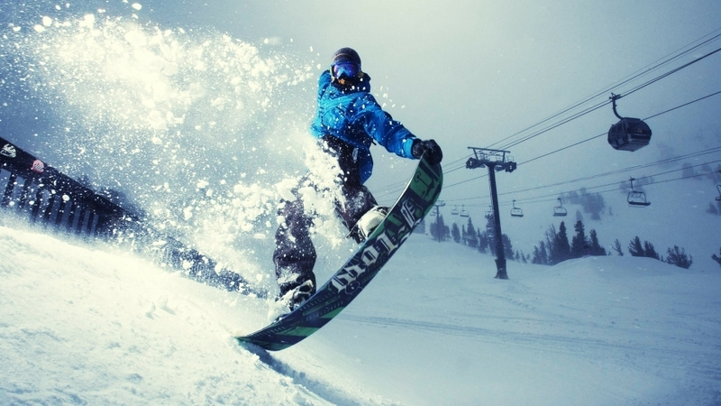
Ski resort IGORA

Slide 18
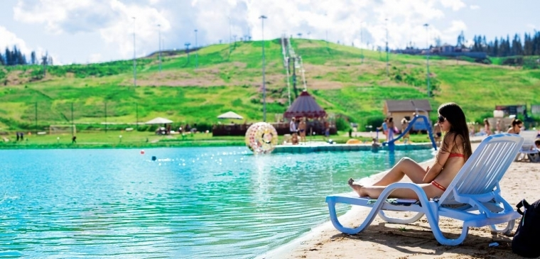
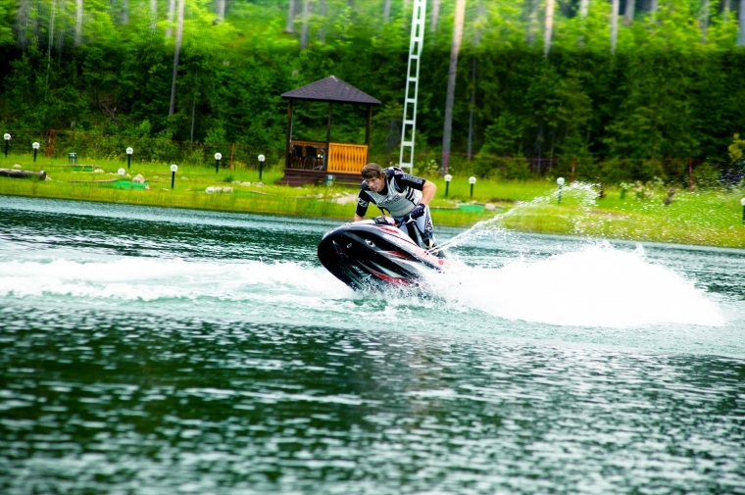

Slide 19
Wind down / Diversify services
Was is the best decision?

Slide 20
Conclusions
Events and seasonal industries study from new perspective
Seasonality, capacity planning, demand decline – issues widely discussed in academic and business areas
Academic contribution - Service operations management development; results may be used in other fields of studies
Practical implications – recommendations for different stages; new model of functioning (in terms of limited resources); strategies to overcome hibernation stage

Slide 21
Plan for further research
Purpose – to develop theory on pulsating organizations.
Objectives: to describe real cases of pulsating organizations; make a set of practices (recommendations).
Grounded theory
RQ: How different stages are managed? How pulsating nature influence managerial practices?
Hypothesis: The managerial aspects and procedures vary from stage to stage.
Hypothesis: Service design model depends on unique characteristics of pulsating organization.
Study design:
Triangulation method: secondary data research, interviews, questionnaires; measuring strategies; KPI (?)

Slide 22
Thank you!

